Slide 1

What makes the world happy?
Nadia Aldrich Carlos Quiroz Dustin Osterman

Slide 2
What is the World Happiness Report?
First published on March 20, 2012 after the UN General Assembly passed a resolution inspired by Bhutan’s philosophy of “Gross Domestic Happiness” which encourages the following:
“giving more importance to happiness and well-being in determining how to achieve and measure social and economic development”
The report is based on a variety of data, but relies mostly on the Gallup World Poll.
Cantril Ladder Scale-
Please imagine a ladder with steps numbered from zero at the bottom to 10 at the top.
The top of the ladder represents the best possible life for you and the bottom of the ladder represents the worst possible life for you.
On which step of the ladder would you say you personally feel you stand at this time?

Slide 3
The 6 Variables of The World Happiness Report
GDP - Quality of life based on money earned.
Family - Quality of life based on family social life.
Health - Healthcare availability and average life expectancy.
Freedom - Freedom to make life choices.
Corruption - Trust in the Government.
Generosity - Based on a country’s involvement in peacekeeping and global aid
Dystopia - A flat rate score (1.85); the avg lowest happiness score from years past plus a residual value.

Slide 4
Hypothesis #1
If a country has a high score in ‘generosity’, then that country will have a higher happiness score.

Slide 5
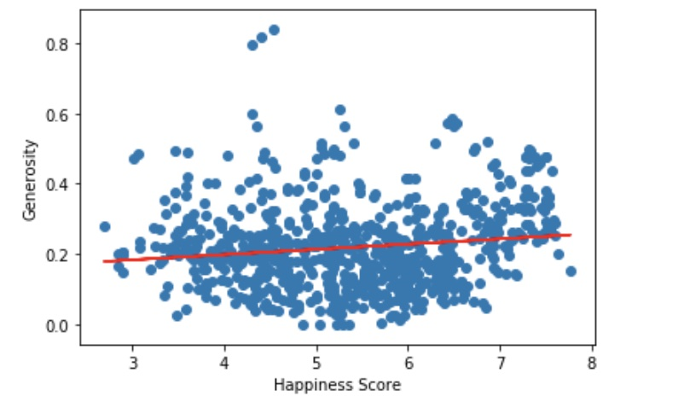
Does generosity have an effect on happiness?
No. In fact, ‘generosity’ is the least impactful of any of our variables on ‘happiness score’.

Slide 6
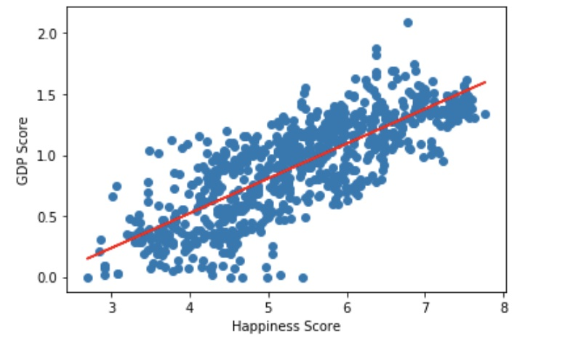
Money!!
Turns out ‘GDP’ is one of the strongest relationship to weather or not a country has a higher ‘happiness score’.
r = .8
Very strong linear relationship.

Slide 7
GPD isn’t the only variable for happiness
If you rank higher in health, family, and freedom then you will have a higher happiness score.

Slide 8
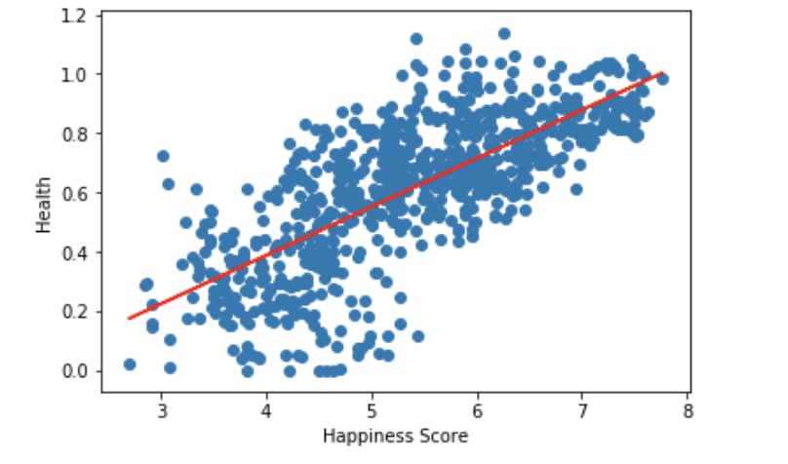
Health
If you have more money you will feel safe in knowing that your medical needs are met.
r = .7
Moderately strong linear relationship.

Slide 9
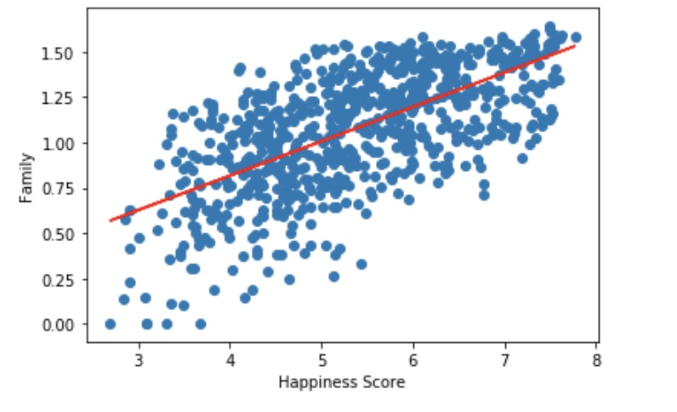
Family
Having a close knit social connection contributes to one's happiness of the heart and mind.
r = .6
Moderate linear relationship.

Slide 10
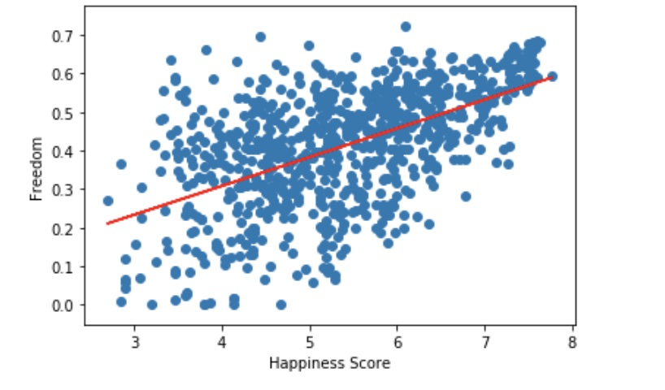
Freedom
The feeling of freedom to do as one pleases will have an overall
r = .6
Moderate linear relationship.

Slide 11
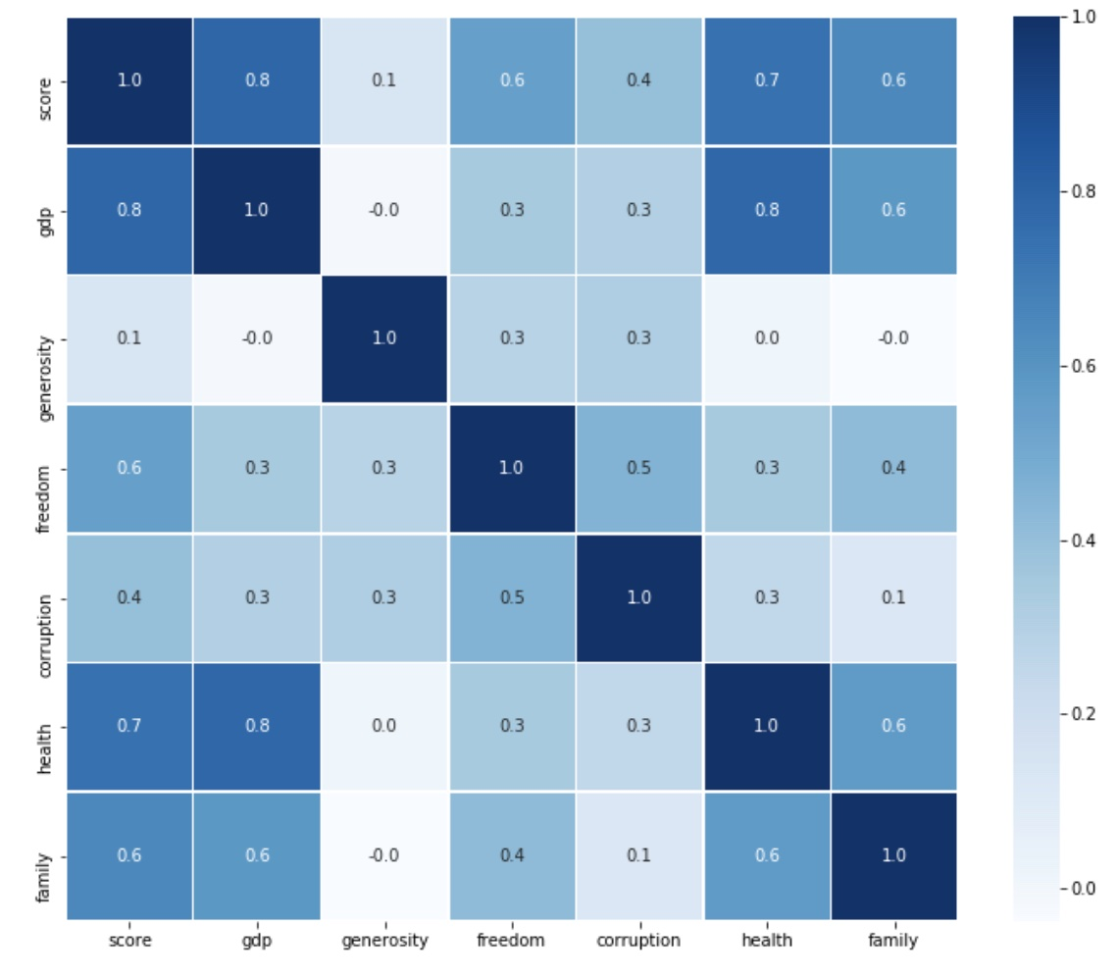
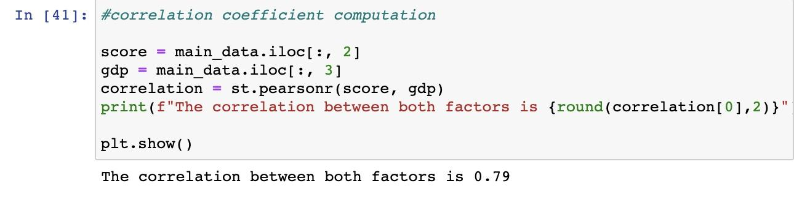
Correlation Map

Slide 12
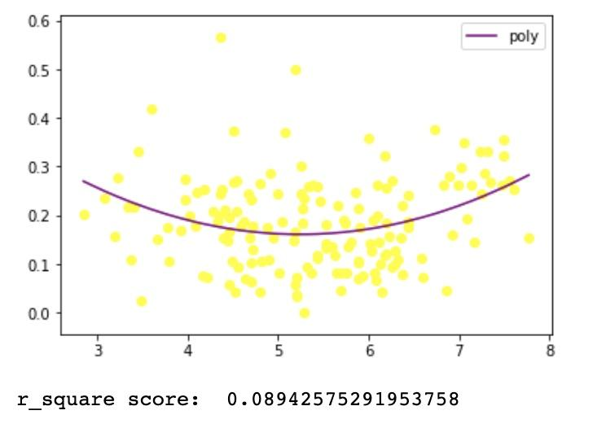
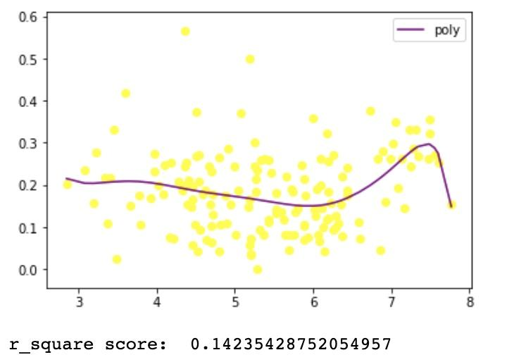
If two variables do not have a strong linear relationship, then we can use a polynomial regression.

Slide 13
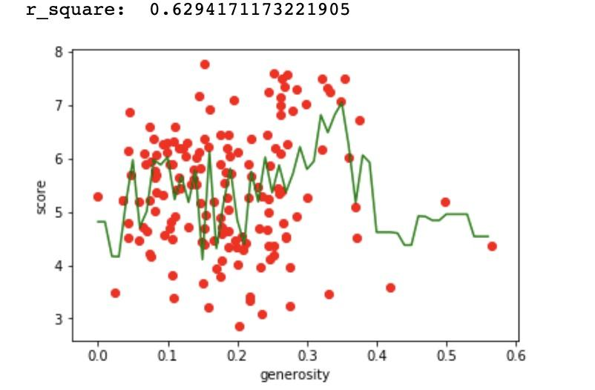
Random Forest Regression

